Slide 1
Searching
Deleting records

Slide 2
Searching: logic
If the search field is not empty
Clean the data
Populate a variable
Else
Set the variable to ‘%’

Slide 3
Show all
SELECT * FROM tbl1 JOIN tbl2 ON (tbl1.countryCode = tbl2.countryCode)
WHERE (tbl1.firstName LIKE '$firstName') AND (tbl1.lastName LIKE '$lastName') etc
'%'

Slide 4
Best Technique use place holders
SELECT * FROM tbl1 JOIN tbl2 ON (tbl1.countryCode = tbl2.countryCode)
WHERE (tbl1.firstName LIKE :first) AND (tbl1.lastName LIKE :last)
$stmt = $pdo->prepare($selectString);
$stmt->bindValue(':first',$firstName);
$stmt->bindValue(':last',$lastName);
$stmt->execute();
Notes:
Consider for empty fields $name = “”;
Could just add wild cards to it whether it is empty or not
$name = “%$name%”;

Slide 5
Searching
Technique 2
Instead of wild characters build the where part of the search string
if($lastName)
{
$selectString .= "AND tblRWCPlayer.lastName LIKE $lastName ";
}
if($position != 'showAll')
{
$selectString .= "AND tblRWCPlayer.position LIKE $position ";

Slide 6
Inserting Data
Getting the last insert ID
If you have just executed an Insert
$lastOne = $pdo->lastInsertId();

Slide 7
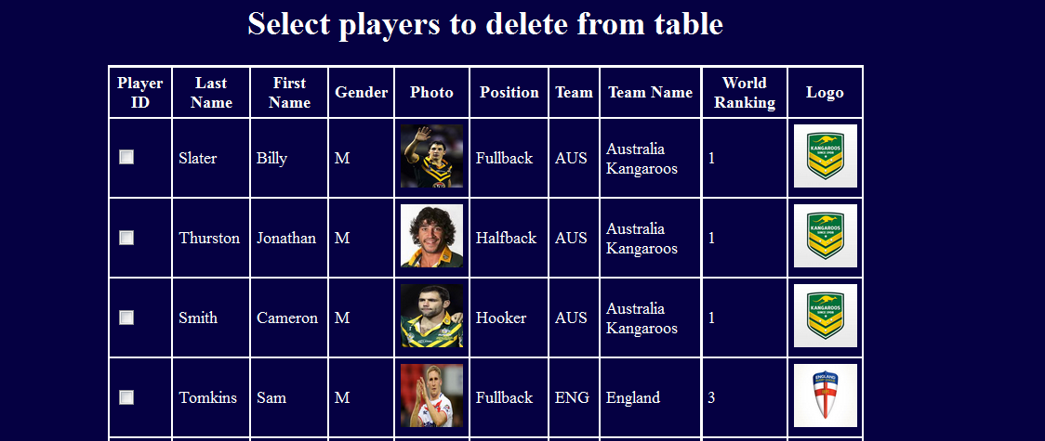
Deleting players
List all players showing only meaningful fields

Slide 8
Deleting Players
Logic
As you are displaying them
If the index is the playerID
Create a check box with an appropriate array name: delete[]
value = that players id which will be in ‘$value’

Slide 9
Logic
Loop through the array deleting the records
DELETE FROM tblPlayers WHERE playerID = $value
Give feedback as to who has been deleted

Slide 10
Feedback
Using exec() to get the number of rows affected
Works with delete, update and insert
Scount =$pdo->exec(SdeleteString);
Note with prepared statements you use execute.
execute is a method of the PDOStatement class it only returns true or false if($stmt->execute($data))
echo "Adding successful";
else
echo "Adding not successful";

